Slide 1
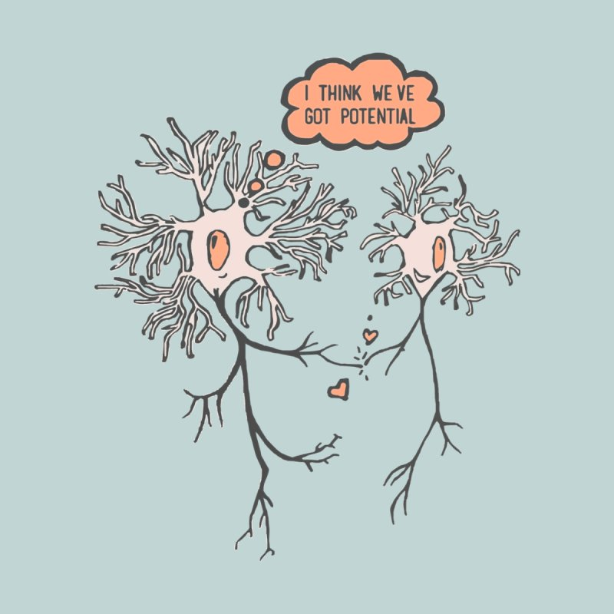
Lab 2
Action Potentials

Slide 2
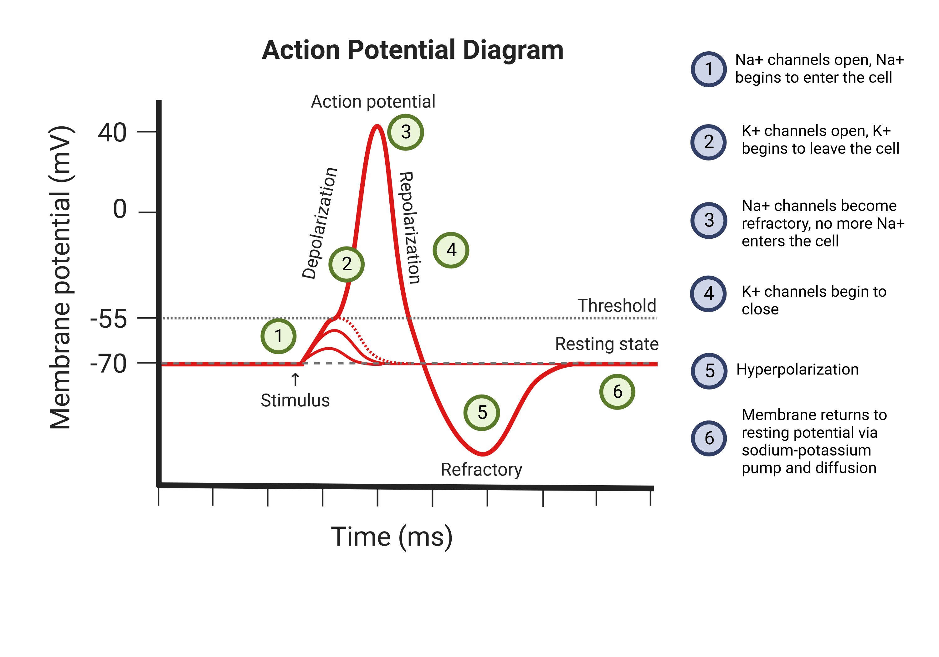

Slide 3
All or Nothing Principle
The action potential occurs when the membrane depolarizes to a certain threshold, if the threshold is not reached the action potential will not be triggered.
The strength of the response (action potential) does not depend on the strength of the stimulus

Slide 4
Due Dates
Tonight before 11:59 pm : Assignment 1 due
Next Class: Quiz 2 and Assignment 2

Slide 5
Assignment 2
The assignment is on canvas!
Expectations:
Follow the instructions carefully!
Graphs should have a title, labeled x and y axis, and data that was collected during the experiment.
The assignment will be a completion grade. Please try your best to give a coherent answer (2-3 sentences).

